Slide 1


Cyberbullying Detection
By:
John Hani
Mohamed Nashaat
Mostafa Ahmed
Zeyad Emad (Team Leader)
Under supervision of :
Dr. Eslam Amer
Eng. Menna Gamil

Slide 2


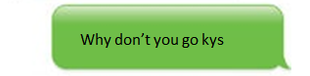
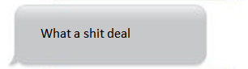
You’re
Trash
Personal pronoun used when directly addressing people
An offensive word when combined with personal pronouns creates a cyberbullying sample

Slide 3

Why
Don’t
you
go
kys
Kys is a slang word which stand for kill yourself also considered as a cyberbullying sample
http://www.noswearing.com/dictionary

Slide 4
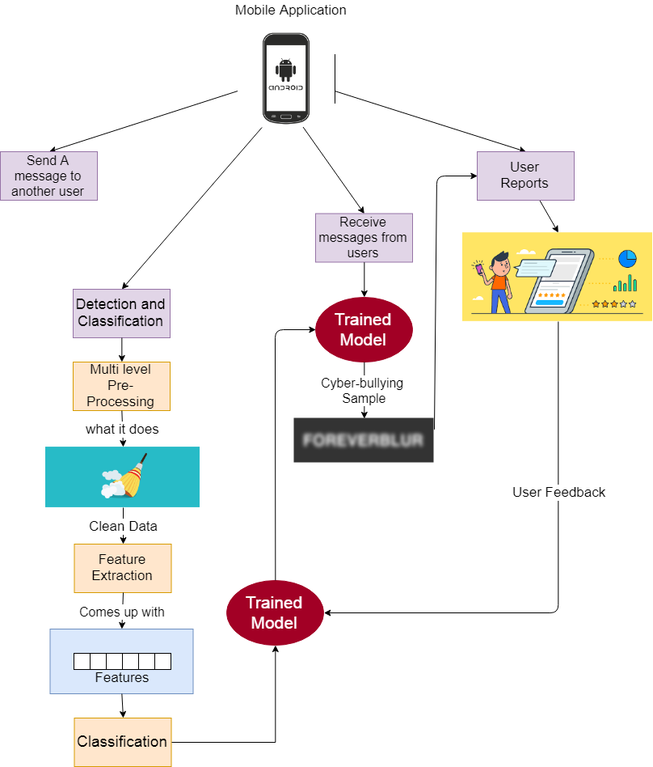

Slide 5
Most Important Algorithm
Sentiment Analysis

Slide 6
Functional Requirement
User | Login with social media Rating
Messages | Send messages & Receive messages Encrypt & Decrypt
Processing | Preprocessing Feature extraction Classification
System | Notify Result Upgrade Classifier

Slide 7



Non Functional Requirements
Security
Maintainability
Portability
Have Encryption and Decryption
Self Learning
Both Desktop and Android

Slide 8
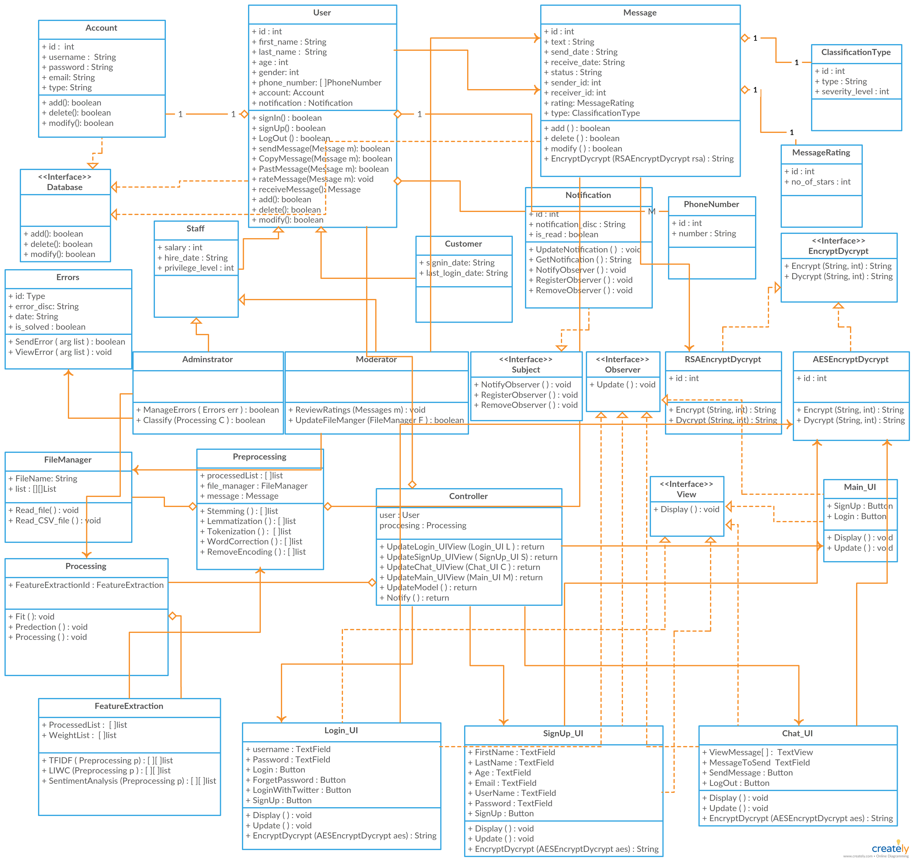
Class Diagram

Slide 9
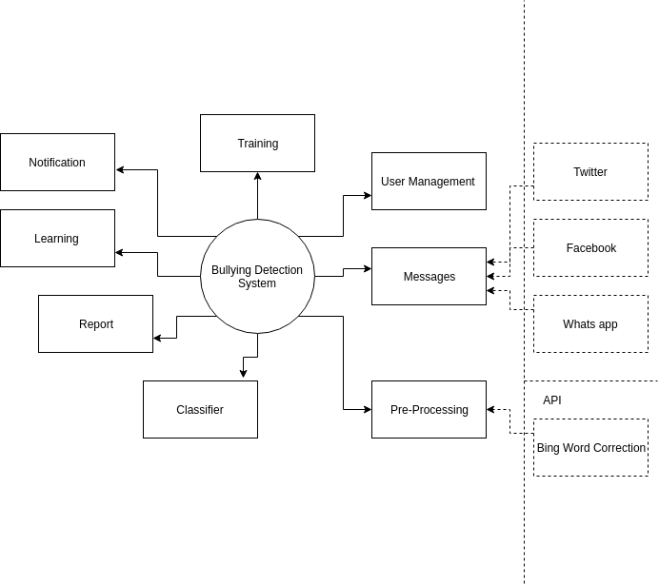
Context Diagram

Slide 10
User Management: Responsible for the Management of the Users Roles
Pre-Processing: Limitization, Stemming,Tokenization, Word Correction Bing API for correction
Processing: (SVM , Random Forest, Naive Bayes)
Reports: Are automatically generated reports about the system overall the number of bully message detected , etc…
Learning: Self-Learning for the system based on the decision taken by the supervisor about the user rating
Notification: Notify the user about the new messages and bully messages received
Training: Train the model by data set or wrong classification
Messages: Receive messages from Twitter, Facebook , Whatsapp API

Slide 11
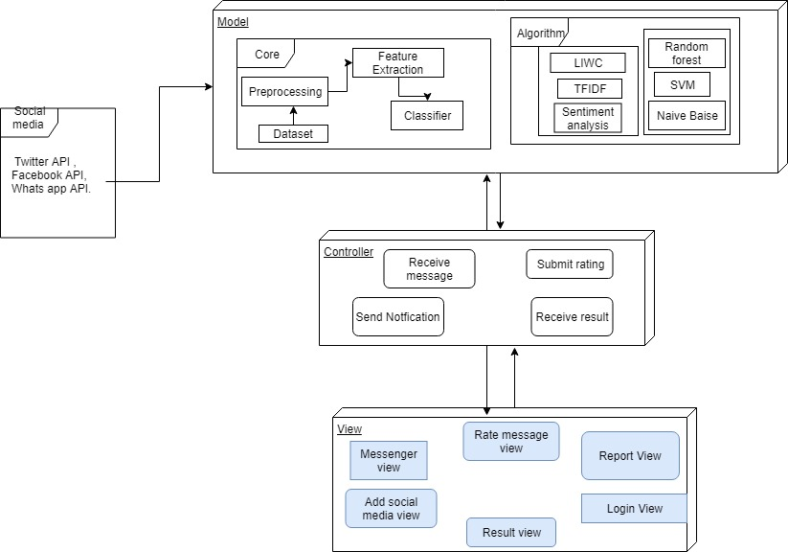
System Architecture

Slide 12
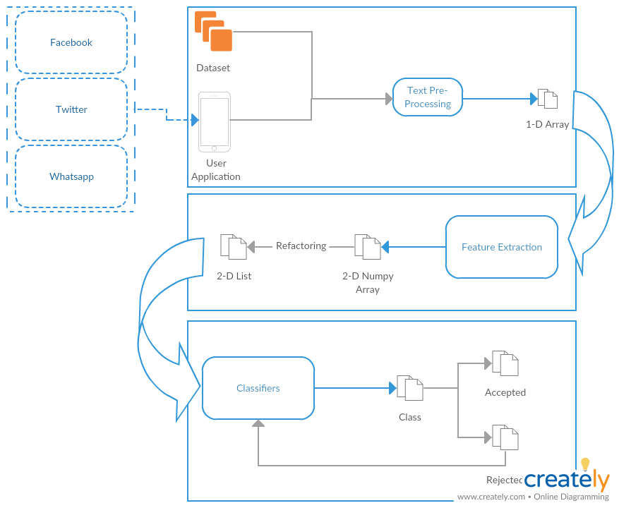
System Overview

Slide 13
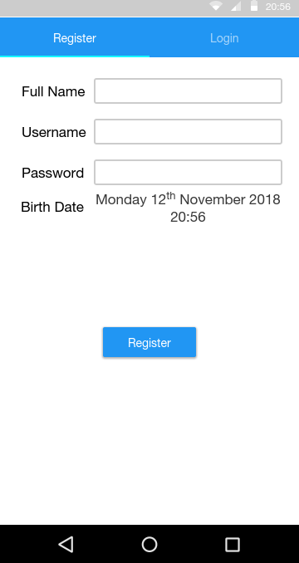
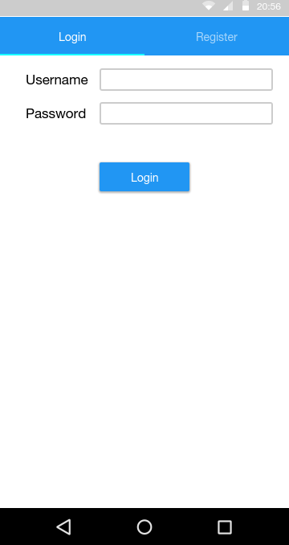
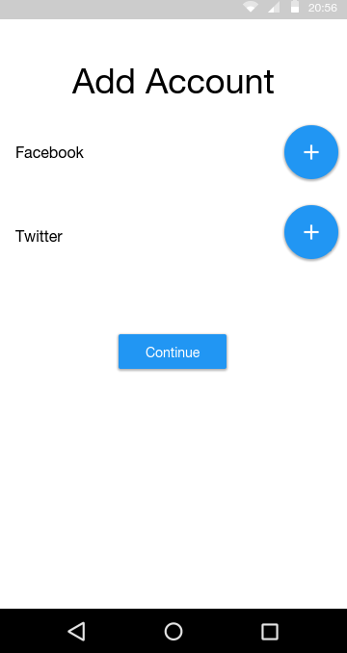
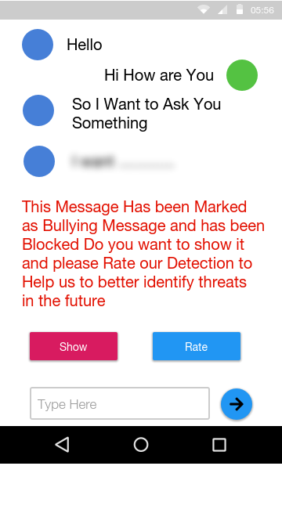
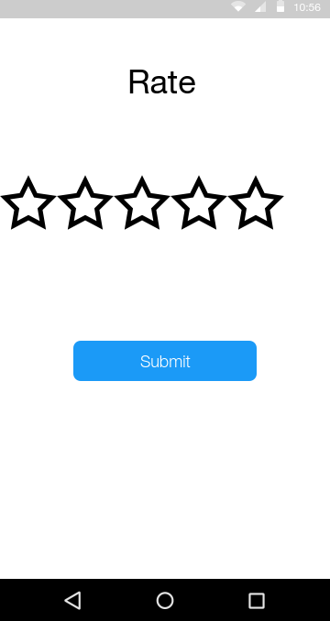
GUI

Slide 14
Demo

Slide 15
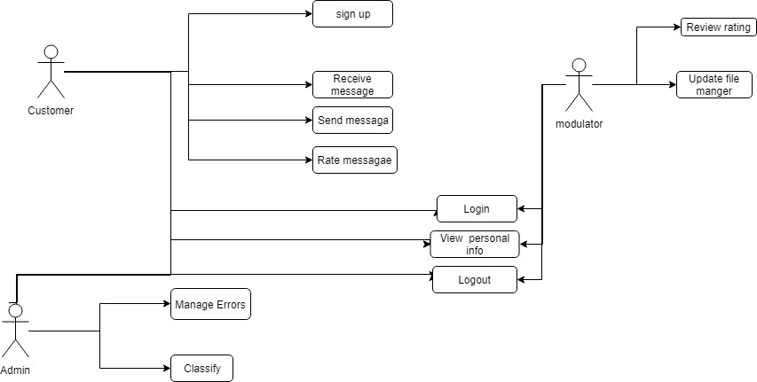
USE Case

Slide 16
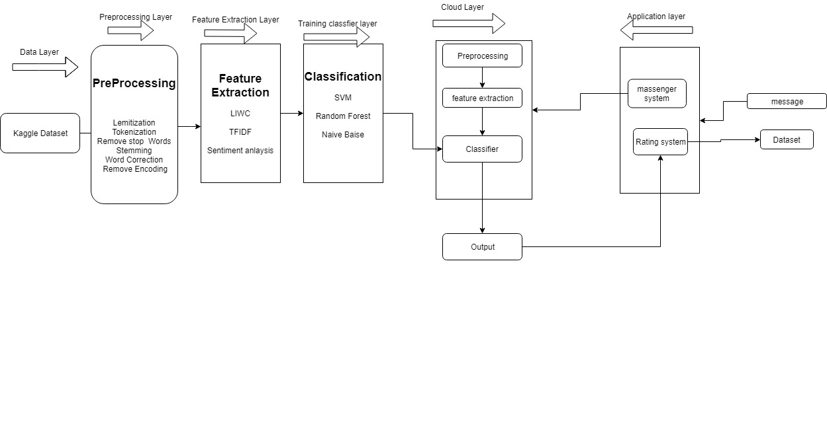
Block diagram

Slide 17
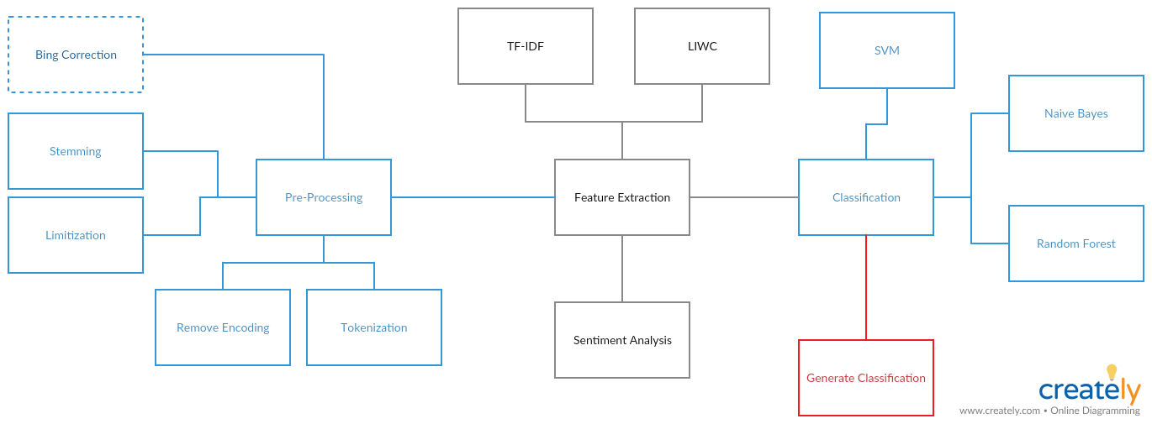
Block diagram

